Slide 1
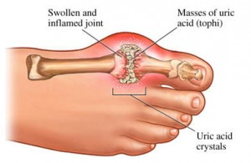
Gout
Gout is caused by elevated levels of uric acid in the blood. The uric acid crystallizes, and the crystals deposit in joints, tendons, and surrounding tissues.
Four phases of gout
Asymptomatic Hyperuricemia
Acute Gout
Intercritical Gout: In between gout attacks
Chronic Tophaceous Gout: Mass formed called tophus is formed between joints
Diagnosis
Urate Crystal | Gold Standard Diagnosed with polarized microscopy
S/S | > 1 acute attack of arthritis Asymmetrical swelling (RA is symmetrical) Joint inflammation within 1 day Tophi

Slide 2
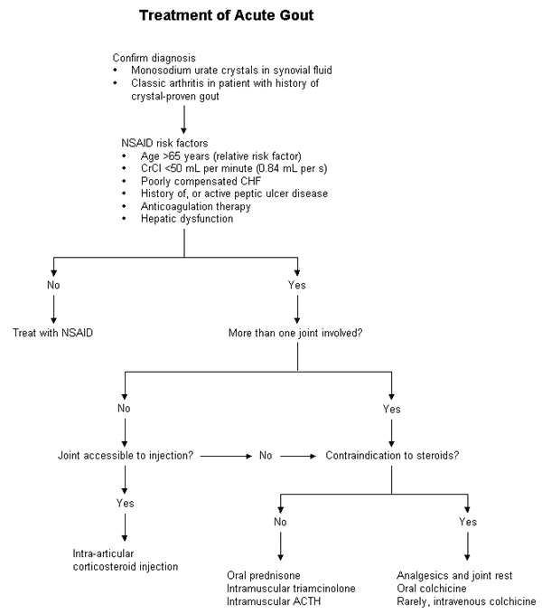
Tx ACUTE Gout:
Drug | Use Next If
NSAID | (algorithm)
Intra-articular Methylprednisolone | More than 1 joint
Prednisone | Serious infection
Colchicine
Notes:
http://www.aafp.org/afp/1999/0215/p925.html

Slide 3
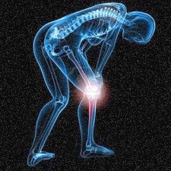
Tx Acute Gout
NOTE: Avoid Aspirin because it retains uric acid
NSAID | Dose
Naproxen (Acute or Prophylaxis) | 500 mg PO BID
Knee-proxen
Corticosteroids | Dose
Intra-articular Methylprednisolone | Small joint 10 – 20 mg Large joint 20 – 60 mg
PO Prednisone | 30 mg PO daily Taper of 7 days

Slide 4
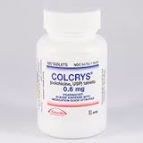
Colchicine (Colcrys)
Normal Dosing
Acute Gout Attack | 1.2 mg PO then 0.6 mg PO one hour later
Gout Prophylaxis | 0.6 mg PO daily
Adverse Effects | GI: Cramping, nausea, diarrhea Rare: myelosuppression, neuro myopathies
Moderate CYP 3A4 inhibitors | Grape fruit, Verapamil, Diltiazem, Fluconazole
Acute Gout Attack | 1.2 mg single dose Do not repeat for 3 days
Gout prophylaxis | 0.3 mg daily
Strong CYP 3A4 inhibitors | Dosing
Acute Gout Attack | 0.6 mg PO then 0.3 mg PO one hour later
Gout prophylaxis | 0.3 mg PO every other day
P-glycoprotein inhibitors | Cyclosporine, Ranolazine
Acute Gout Attack | 0.6 mg PO do not repeat for 3 days
Gout prophylaxis | 0.3 mg PO every other day
Notes:
Colchicine is known to have a narrow therapeutic index, or a narrow margin of safety between doses that are therapeutic and doses that are toxic. Many of the adverse events associated with colchicine are dose-related.
i.v. colchicine. Among the commonly reported events were neutropenia (low number of white blood cells), acute renal (kidney) failure, thrombocytopenia (low number of platelets), congestive heart failure, and pancytopenia (low number of all types of blood cells). Many of these adverse events are caused by colchicine toxicity, which can have serious and potentially fatal consequences.

Slide 5
Other Tx for Gout
 | Pegloticase (Krytexxa) | Rasburicase (Elitek)
Indication | Chronic gout refractory to conventional therapy | For pediatric population With childhood leukemias:
MOA | -- | Oxidizes uric acid to allantoin
Dose | 8 mg IV q2 weeks + Antihistamine IV over 2 hr + Corticosteroids IV over 2 hr | 0.15-0.2 mg/kg IV push for 5-7 days
Screening | CI if G6PD | CI if G6PD
Monitor | Anaphylaxis (give H1 and steroids)

